Slide 1
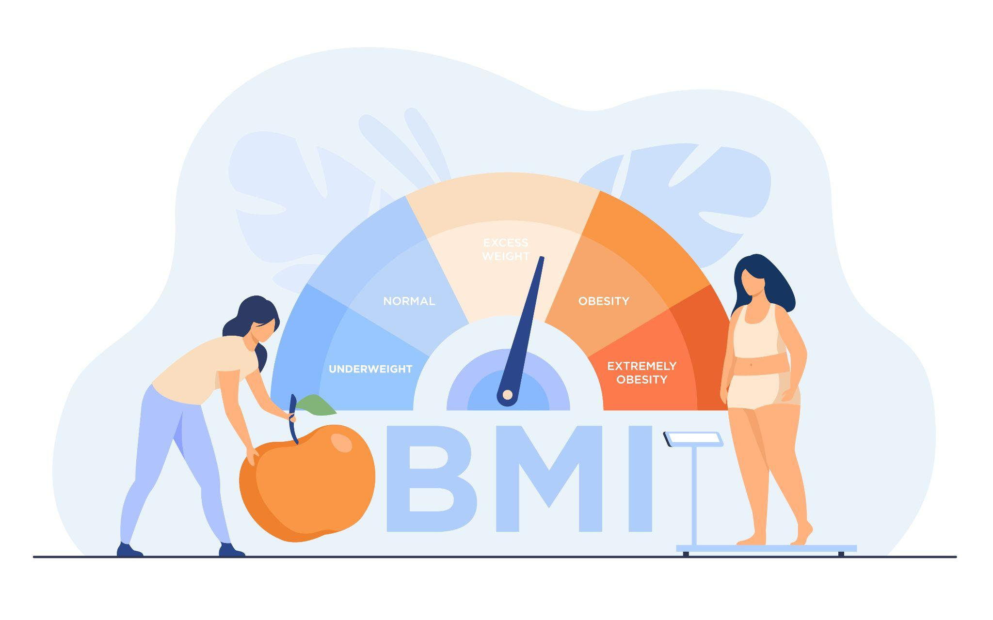
Exploring Body Mass Index: Unveiling key predictors
What are economic and development influences on BMI?
By Group 4 - Mazen Alhaffar, San Nguyen, and Rohitha Sai Kothapalli

Slide 2
Table of contents
01
Introduction
04
Model analysis
02
05
Visualization
Data Dictionary
03
Data collection & cleaning
06
Q&A

Slide 3
Introduction
Body Mass Index (BMI) is a key indicator of an individual’s health and is widely used to assess the prevalence of underweight, overweight, and obesity in populations.
01
02
Patients
Insurance Industry
a low-cost assessment to quickly update patients' health status
Offer tailored insurance plans
03
04
Public health initiatives
Healthcare providers
Target at-risk communities and create health strategies
Evaluate health risks and tailor affordable treatments

Slide 4
Data Dictionary
Variable | Description | Type | Unit
Average BMI | The average Body Mass Index (BMI) of the population in each country. | Numerical (continuous) | BMI (kg/m²)
GDP | The Gross Domestic Product (GDP) of the country. | Numerical (continuous) | US Dollars
Globalization Index | A country’s global integration based on economic, social, and political fields. | Numerical (continuous) | Index score
Urbanization rate | The percentage of the population living in urban areas. | Numerical (continuous) | Percentage(%)
Human Capital Index | Measure a child's potential productivity based on education and health outcomes. | Numerical (continuous) | Range between 0 and 1
Year | The year when Body Mass Index (BMI) data was collected for various countries. | Numerical (discrete) | Year
Notes:
The HCI measures how well a country mobilizes the economic and professional potential of its citizens and how much capital an economy loses due to poor education and health

Slide 5
Problem Statement
How global and country-level economic and socio-demographic factors like GDP, Urbanization, and Globalization Index impact BMI?

Slide 6
Obtaining Data
01
03
02
200 different countries
between 1975 and 2014
19.2 million adult participants, including 9.9 million men and 9.3 women
The data was retrieved from Mendeley Data
Database collected by the NCD Risk Factor Collaboration.

Slide 7
Data Cleaning
Prior to running the data:
Simple process consisting of removing the data guide and codes along with the link to the dataset.
Blank entries were changed to zero to avoid errors when running regressions.
Adding Average BMI variable that captures the average of BMI for females and males.
After running the data:
Removing superfluous variables.
Transforming character data types to factor.
Releveling the levels of factors to reference United States of America
Disposing of outliers.

Slide 8
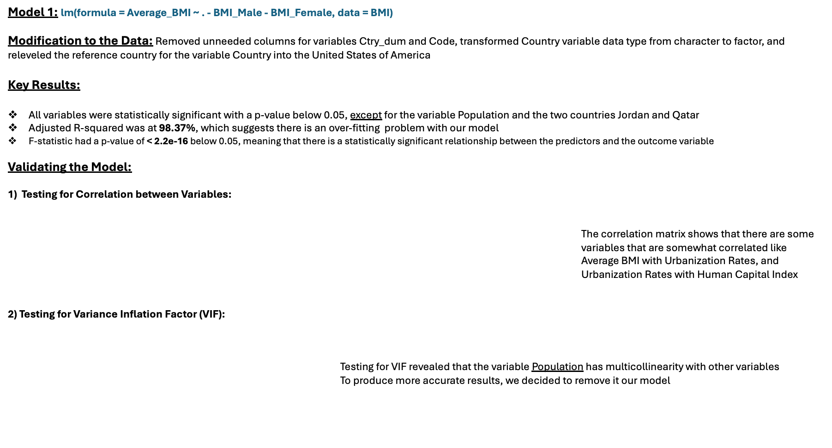
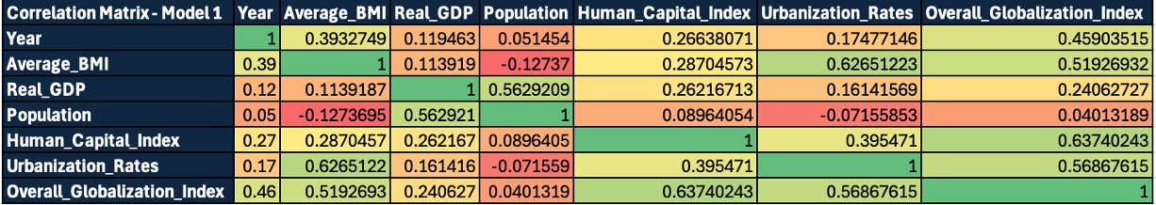
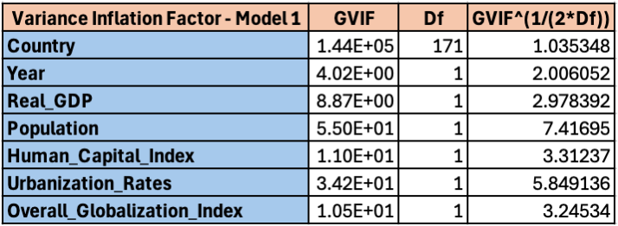
Running the Models – Model 1

Slide 9
Running the Models – Model 2 (Without Population)
Model 2: lm(formula = Average_BMI ~ . - BMI_Male - BMI_Female - Population, data = BMI)
Modification to the Data: None
Key Results:
All variables were statistically significant with a p-value below 0.05, except for the two countries Jordan and Qatar.
Adjusted R-squared was at %98.37, there was clearly an over-fitting issue with our model, which may cause the model to end up fitting random fluctuations in the data rather than genuine relationships.
F-statistic had a p-value of < 2.2e-16 below 0.05, meaning that there is a statistically significant relationship between the predictors and the outcome variable.

Slide 10
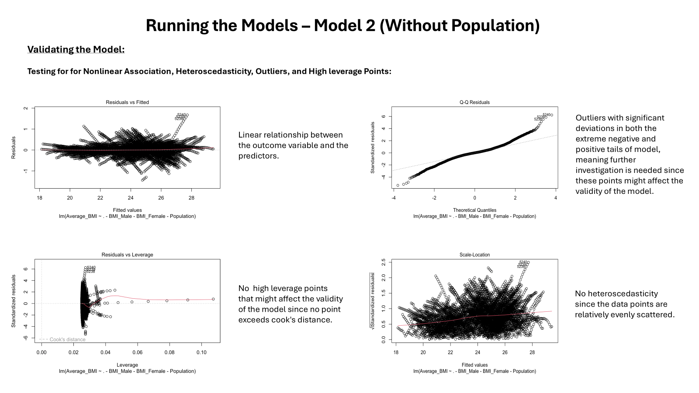

Slide 11
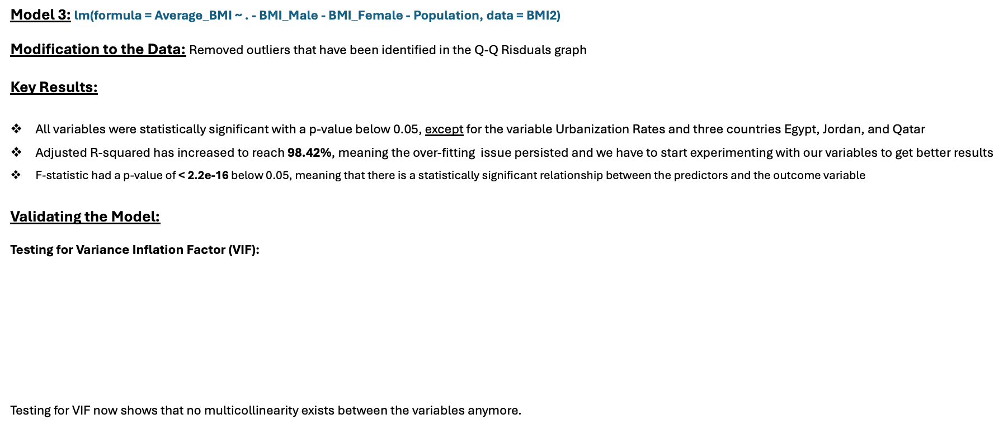
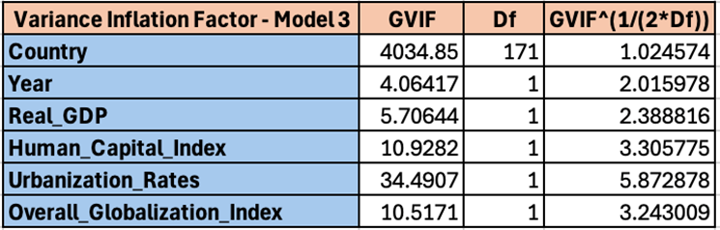
Running the Models – Model 3 (Removing Outliers)

Slide 12
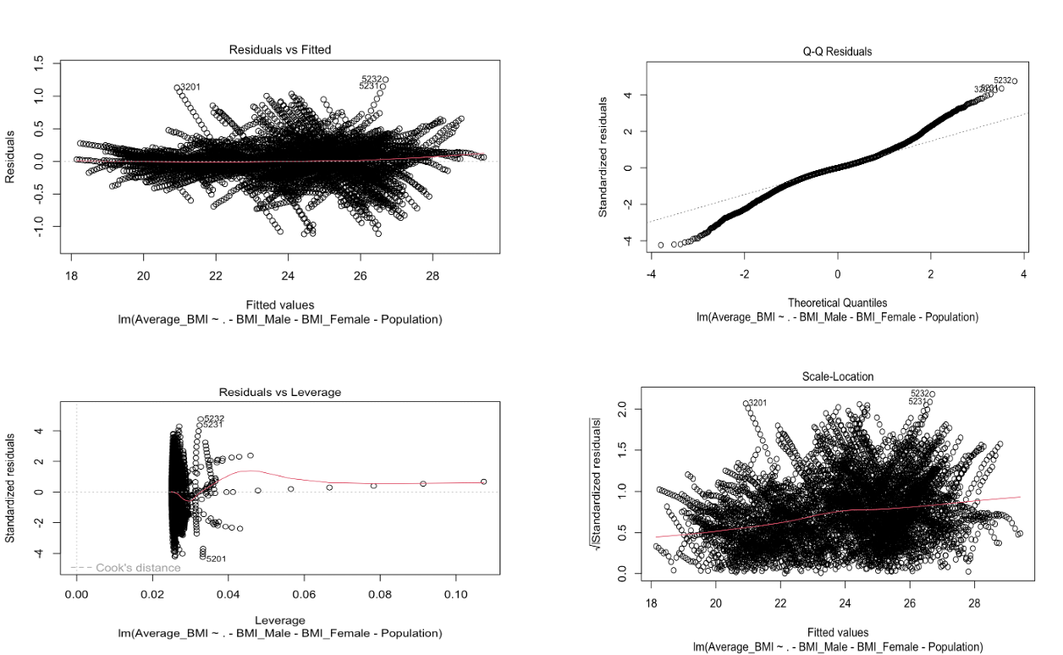
Running the Models – Model 3 (Removing Outliers)
Validating the Model:
Testing for for Nonlinear Association, Heteroscedasticity, Outliers, and High leverage Points:
No major changes were witnessed in the residuals graphs

Slide 13
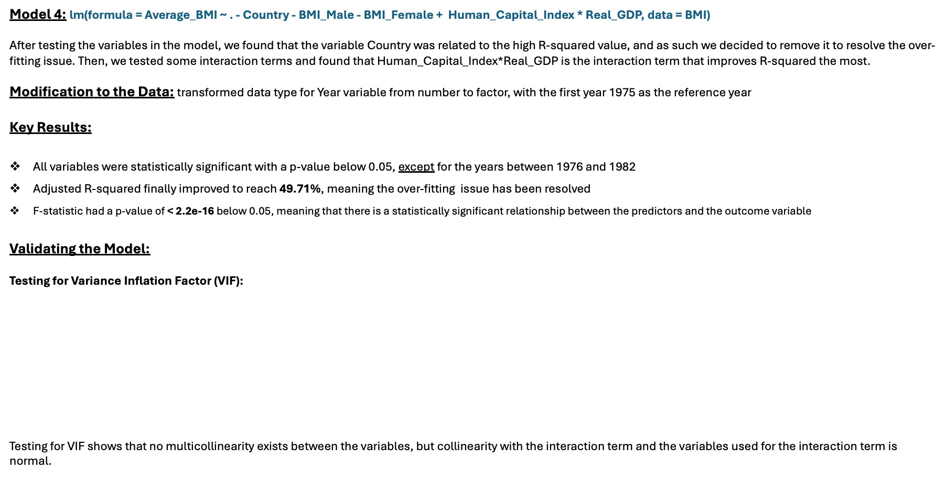
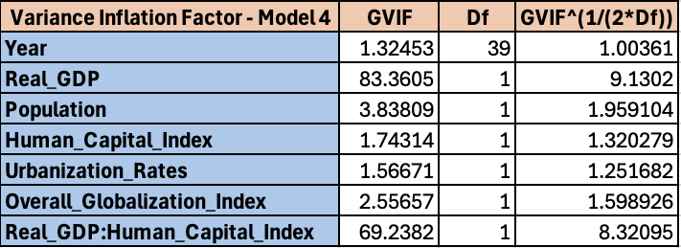
Running the Models – Model 4 (Removing Country and Testing for Interaction Terms)

Slide 14
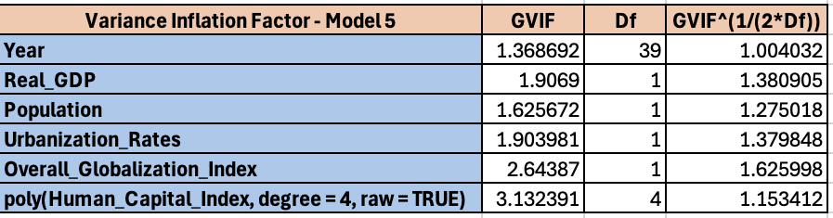
Running the Models – Model 5 (Removing Country and Testing for Polynomial Terms)
Model 5: lm(formula = Average_BMI ~ . - Human_Capital_Index - Country - BMI_Male - BMI_Female + poly(Human_Capital_Index, degree = 4, raw = TRUE), data = BMI)
Testing for polynomial terms landed a better R-squared, with degree 4 producing the most significant results.
Modification to the Data: None
Key Results:
All variables were statistically significant with a p-value below 0.05, except for the years between 1976 and 1984
Adjusted R-squared finally improved to reach 57.85%, meaning the over-fitting issue has been resolved
F-statistic had a p-value of < 2.2e-16 below 0.05, meaning that there is a statistically significant relationship between the predictors and the outcome variable
Validating the Model:
Testing for Variance Inflation Factor (VIF):
Checking for collinearity produced favorable results as no variable is correlated to other variables.

Slide 15
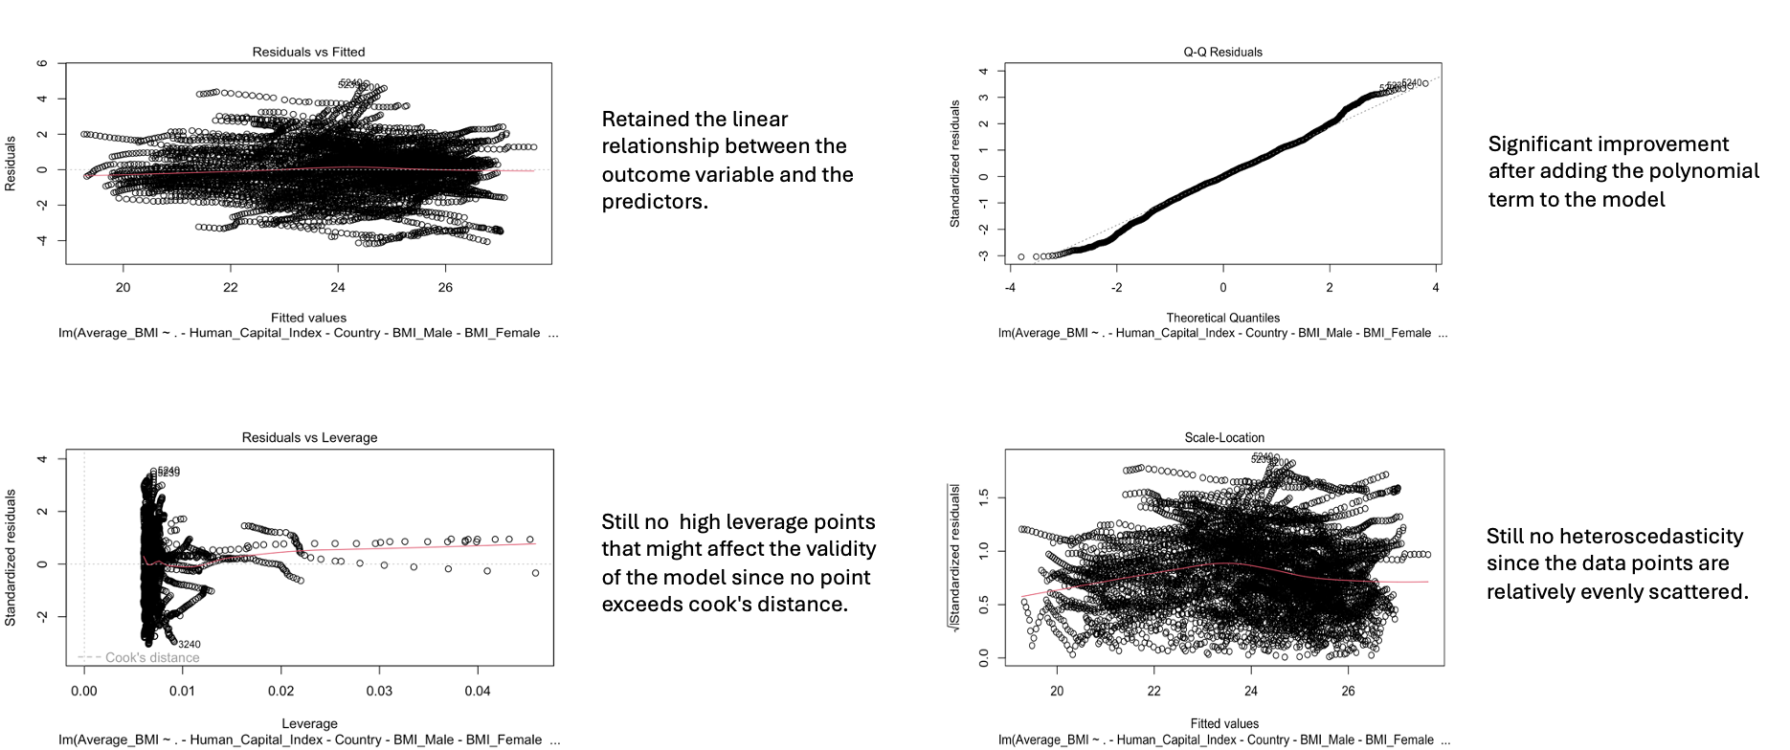
Running the Models – Model 5 (Removing Country and Testing for Polynomial Terms)
Validating the Model:
Testing for for Nonlinear Association, Heteroscedasticity, Outliers, and High leverage Points:

Slide 16
Model 5 Results
Call:
lm(formula = Average_BMI ~ . - Human_Capital_Index - Country -
BMI_Male - BMI_Female + poly(Human_Capital_Index, degree = 4,
raw = TRUE), data = BMI)
Residuals:
Min 1Q Median 3Q Max
-4.1940 -0.8428 0.0071 0.8826 4.8697
Coefficients:
Estimate Std. Error t value Pr(>|t|)
(Intercept) 2.187e+01 1.192e-01 183.476 < 2e-16 ***
Year1976 3.078e-02 1.493e-01 0.206 0.836721
Year1977 6.199e-02 1.493e-01 0.415 0.678049
Year1978 9.334e-02 1.493e-01 0.625 0.531995
Year1979 1.206e-01 1.494e-01 0.808 0.419251
Year1980 1.558e-01 1.494e-01 1.043 0.296905
Year1981 1.795e-01 1.494e-01 1.202 0.229580
Year1982 2.145e-01 1.494e-01 1.436 0.151180
Year1983 2.440e-01 1.494e-01 1.633 0.102593
Year1984 2.736e-01 1.495e-01 1.831 0.067176 .
Year1985 3.053e-01 1.495e-01 2.043 0.041138 *
Year1986 3.438e-01 1.495e-01 2.300 0.021497 *
Year1987 3.860e-01 1.495e-01 2.582 0.009850 **
Year1988 4.254e-01 1.495e-01 2.845 0.004460 **
Year1989 4.779e-01 1.495e-01 3.196 0.001400 **
Year1990 5.239e-01 1.497e-01 3.500 0.000467 ***
Year1991 5.142e-01 1.498e-01 3.433 0.000601 ***
Year1992 5.419e-01 1.499e-01 3.616 0.000301 ***
Year1993 5.652e-01 1.500e-01 3.768 0.000166 ***
Year1994 5.985e-01 1.501e-01 3.988 6.74e-05 ***
Year1995 6.272e-01 1.502e-01 4.175 3.01e-05 ***
Year1996 6.719e-01 1.503e-01 4.471 7.93e-06 ***
Year1997 7.103e-01 1.504e-01 4.722 2.38e-06 ***
Year1998 7.481e-01 1.506e-01 4.969 6.88e-07 ***
Year1999 7.875e-01 1.507e-01 5.226 1.79e-07 ***
Year2000 8.269e-01 1.509e-01 5.482 4.37e-08 ***
Year2001 8.777e-01 1.509e-01 5.815 6.33e-09 ***
Year2002 9.310e-01 1.510e-01 6.167 7.36e-10 ***
Year2003 9.781e-01 1.511e-01 6.474 1.02e-10 ***
Year2004 1.018e+00 1.512e-01 6.732 1.81e-11 ***
Year2005 1.069e+00 1.513e-01 7.066 1.75e-12 ***
Year2006 1.105e+00 1.514e-01 7.299 3.22e-13 ***
Year2007 1.142e+00 1.516e-01 7.534 5.57e-14 ***
Year2008 1.194e+00 1.516e-01 7.875 3.94e-15 ***

Slide 17
Model 5 Results
Year2009 1.245e+00 1.516e-01 8.208 2.67e-16 ***
Year2010 1.288e+00 1.517e-01 8.489 < 2e-16 ***
Year2011 1.336e+00 1.517e-01 8.804 < 2e-16 ***
Year2012 1.379e+00 1.518e-01 9.089 < 2e-16 ***
Year2013 1.424e+00 1.518e-01 9.376 < 2e-16 ***
Year2014 1.462e+00 1.520e-01 9.619 < 2e-16 ***
Real_GDP 1.040e-07 2.030e-08 5.122 3.10e-07 ***
Population -2.455e-03 1.771e-04 -13.863 < 2e-16 ***
Urbanization_Rates 2.994e-02 9.613e-04 31.144 < 2e-16 ***
Overall_Globalization_Index 1.472e-02 1.247e-03 11.801 < 2e-16 ***
poly(Human_Capital_Index, degree = 4, raw = TRUE)1 -1.001e+01 3.743e-01 -26.748 < 2e-16 ***
poly(Human_Capital_Index, degree = 4, raw = TRUE)2 1.075e+01 4.867e-01 22.087 < 2e-16 ***
poly(Human_Capital_Index, degree = 4, raw = TRUE)3 -3.804e+00 2.042e-01 -18.629 < 2e-16 ***
poly(Human_Capital_Index, degree = 4, raw = TRUE)4 4.391e-01 2.763e-02 15.891 < 2e-16 ***
- - -
Signif. codes: 0 ‘***’ 0.001 ‘**’ 0.01 ‘*’ 0.05 ‘.’ 0.1 ‘ ’ 1
Residual standard error: 1.385 on 6832 degrees of freedom
Multiple R-squared: 0.5814, Adjusted R-squared: 0.5785
F-statistic: 201.9 on 47 and 6832 DF, p-value: < 2.2e-16
Highlighted results:
Model 5 captures the non-linear relationship between Human capital index and Average BMI, as evident by the variation in the slope amount between each degree in the polynomial term.
Notes:
Explain meaning of year variable in this model:

Slide 18
Empirical Results
Intercept (Estimate: 21.87):
Represents the baseline Average BMI when all other factors are zero, providing a reference point for interpretation.
Year Variables (Years: 1976-2014) (Estimates: Range from 0.03078 to 1.462):
Shows how Average BMI has increased over time, reflecting global trends like changing diets and lifestyles.
Real GDP(Estimate: 1.040e-07):
Indicates that higher economic growth is linked to a slight increase in BMI, possibly due to the fact that people have better access to resources because of the improved economic situation.
Population (Estimate: -0.002455):
Suggests that larger populations are associated with a small decrease in BMI, likely due to differences in resource distribution that affect lifestyle and nutrition, and more variability will show with increased amount of individuals in society.
Urbanization Rates (Estimate: 0.02994):
Implies that more urbanization leads to a slight higher BMI, likely because of more sedentary lifestyles and processed food availability that may cause weight gain.
Globalization Index (Estimate: 0.01472):
Shows that greater globalization correlates with a slight higher Average BMI, as international food trends influence local diets with more access to junk food.
Polynomial Terms for Human Capital Index (degree = 4, Estimates: Range from -10.01 to 0.4391):
Captures the complex non-linear relationship between the Human Capital Index and Average BMI, Initially, higher human capital might reduce BMI due to better health knowledge and practices. However, at higher levels, other factors (such as changes in lifestyle with more sedentary jobs) might reverse this trend, leading to higher BMI.

Slide 19
Model Benefits & Real-World Applications
This model provides valuable insights for understanding how large-scale societal shifts impact public health, particularly around weight-related issues. Knowing these connections helps communities, governments, and health organizations create better plans and policies to improve public health, as it can be used in the following:
Health Organizations: To design programs targeting obesity or undernourishment, especially in areas undergoing economic or urban changes.
Government Policy Makers: To understand how changes in urbanization or globalization can affect public health and to create policies that encourage healthy living in growing cities.
Public Health Researchers: To study how global trends are shaping people’s health, allowing them to recommend evidence-based interventions.
Urban Planners and Economists: To consider how city growth and economic shifts impact health, allowing them to design more health-conscious urban environments.

Slide 20
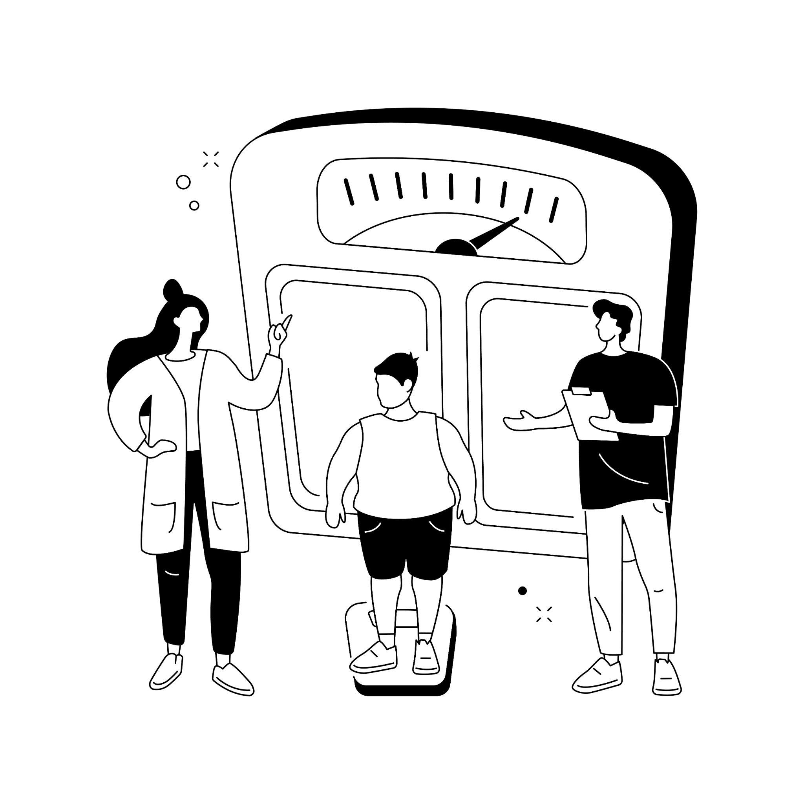
Conclusion
The multiple linear regression model effectively captures the influence of socio-economic and demographic factors on average BMI, accounting for 57.85% of the variation. Economic growth is positively associated with rising BMI, while the Human Capital Index demonstrates a more complex, non-linear effect.

Slide 21
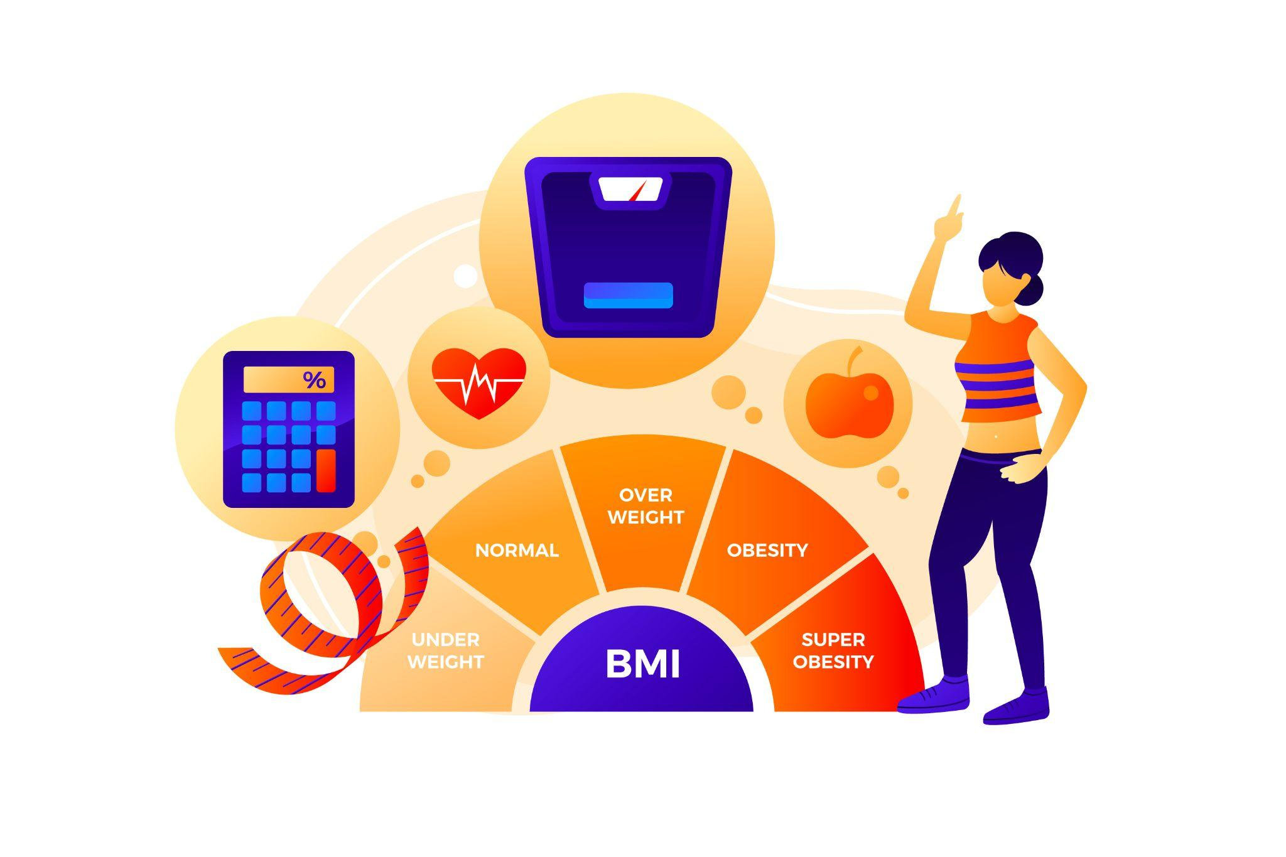

Thank you

Slide 22
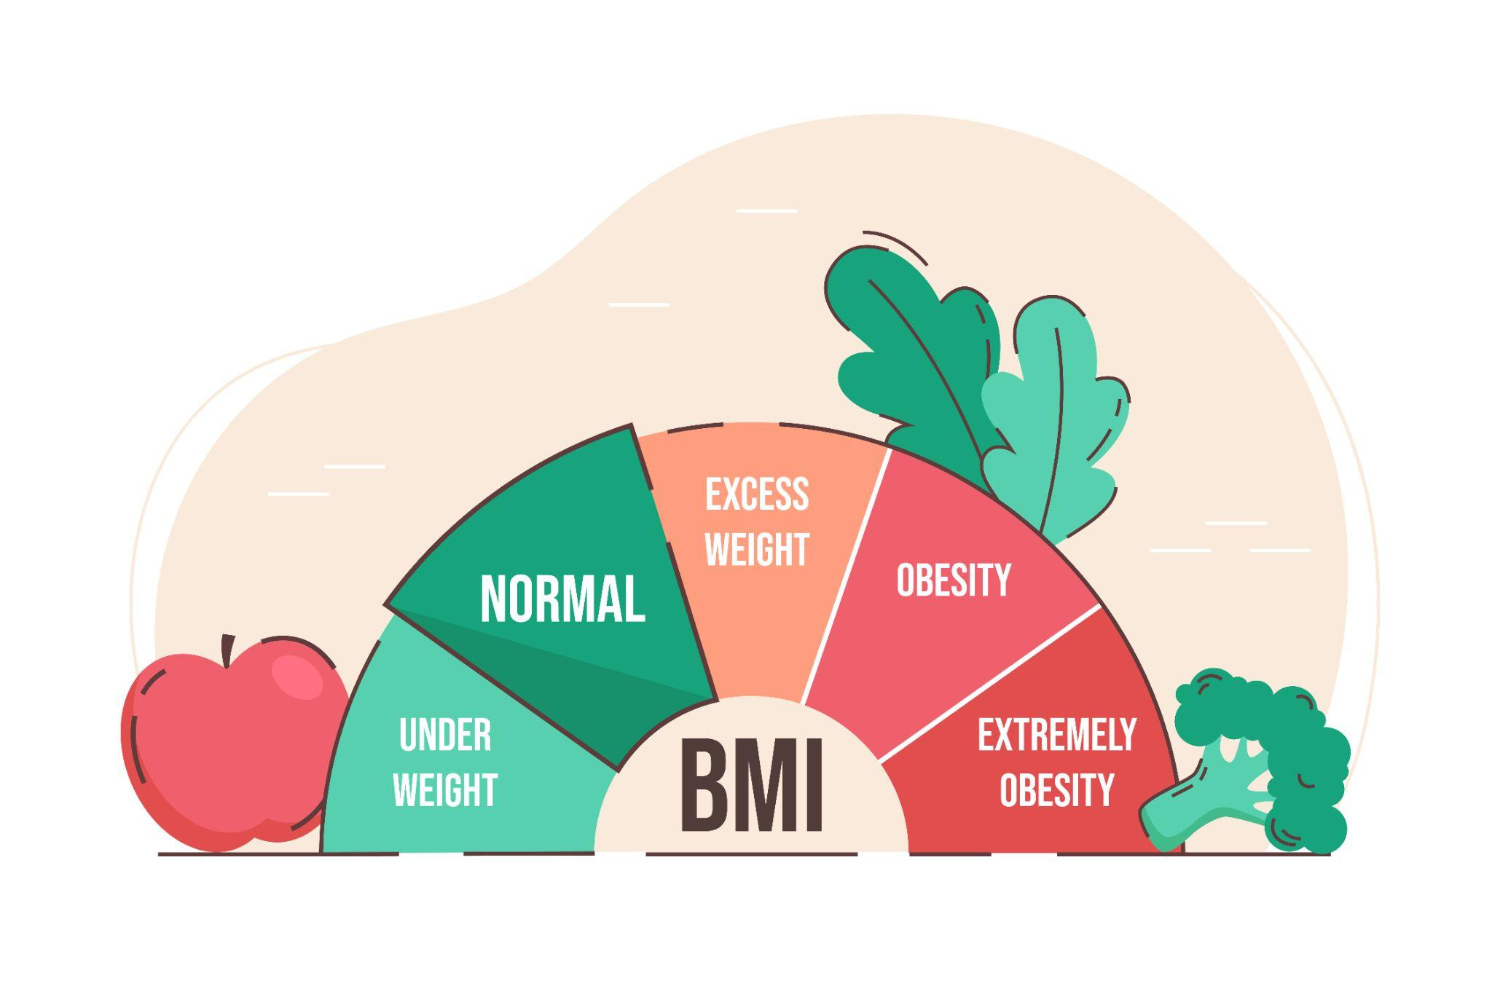

Q&A

